Slide 1


The Next
Workspace Revolution
Is Global
Exploring Coworking Potential in the Age of Digital Nomads

Slide 2
Digital Nomads
are someone who earns a living remotely via the internet, usually while traveling and living nomadically.

Slide 3


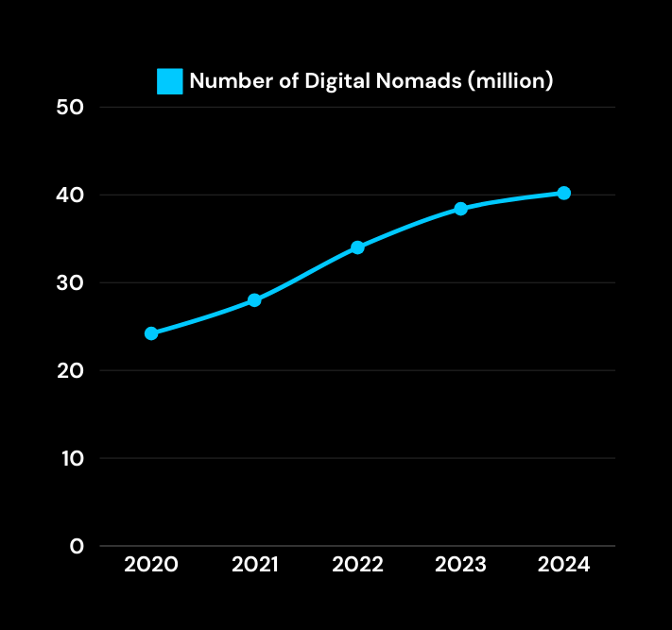
Work has gone borderless
40 MILLION
There are an estimated 40 million digital worldwide.
$787 BILLION
Digital nomads contribute a global economic value of $787 billion per year.
Data comes from STATISTA, Harvard International Review.

Slide 4
Where Will the Next Office Be?
Using insight to uncover the next coworking opportunity.

Slide 5




Research Questions
MARKET DISCOVERY
WHITE SPOT ANALYSIS
NOMAD INSIGHTS
HYPOTHESIS
Where are digital nomads going?
What drives nomads' city preference?
How do lifestyle factors shape their choices?
Where is the demand rising... but supply falling short?
Where have the big players WeWork missed — and opportunity wide open?
How long do they stay?
What do they do for work?
Cities with lower cost of living attract more digital nomads.
Cities with higher quality of life host significantly more digital nomads.

Slide 6
From scattered sources
to insights
Using insight to uncover the next coworking opportunity.

Slide 7
Data Sources & Datasets
DIGITAL NOMAD BEHAVIOR & PRESENCE
3. GLOBAL CONTEXTUAL DATA
Nomadlist.com – User data, city rankings, digital nomad counts
(Web scraping)
Global Cost of Living – Numbeo Index
Quality of Life Index – Country-level metrics
Average Internet Speed (2022) – Speedtest Global Index
(Kaggle)
2. COWORKING & MARKET SUPPLY
WeWork Locations – Official website data and sitemap
(Web scraping)

Slide 8

They’re young, skilled, and earning well
32
AVERAGE AGE*
€78,200
MEDIAN INCOME / YEAR*
*Data comes from Nomadlist.com.

Slide 9

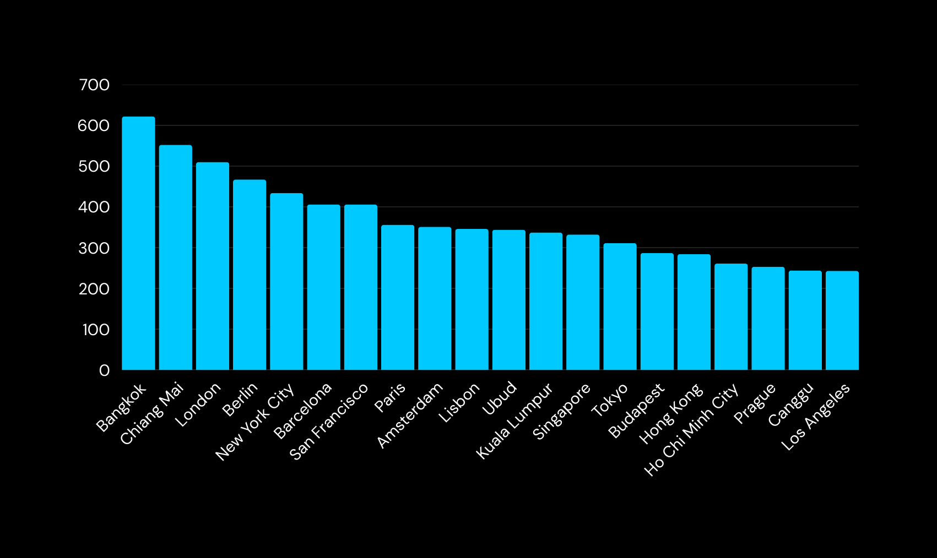
Where Are Digital Nomads Going?

Slide 10
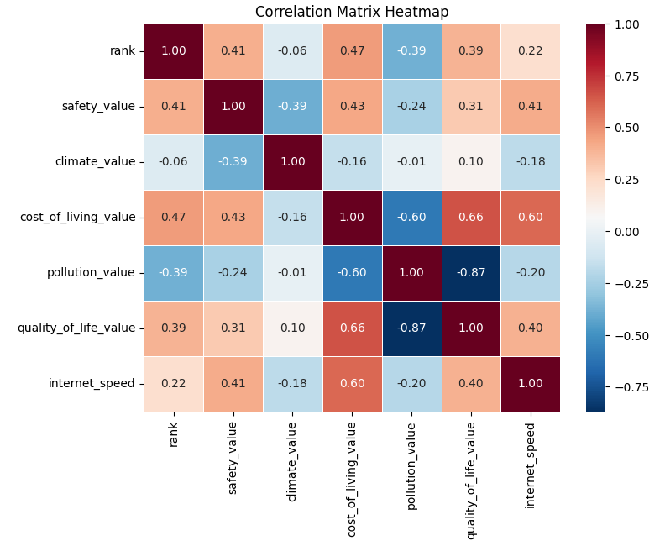
What Drives Nomads' City Preference?
How lifestyle, cost, and internet correlate with city rankings.
Ranking data sourced from Nomadlist.com

Slide 11
Market Opportunity
Identifying cities where digital nomads are growing — but workspaces haven’t.

Slide 12
The Co-working Industry Is Growing
€13.72
BILLION WORTH IN 2023*
15%
PREFER COWORKING SPACES OVER CAFÉS OR AIRBNB*
15.7%
EXPECTED TO GROW EVERY YEAR UNTIL 2030*
*Data comes from Grand View Research.

Slide 13

Where Is the Demand Rising but Supply Falling Short?
Comparing digital nomad hotspots to WeWork’s global footprint.

Slide 14
Zooming In: Where Can We Fill the Gap?
A deep dive into high-potential countries with growing digital nomad populations and underdeveloped coworking supply.

Slide 15
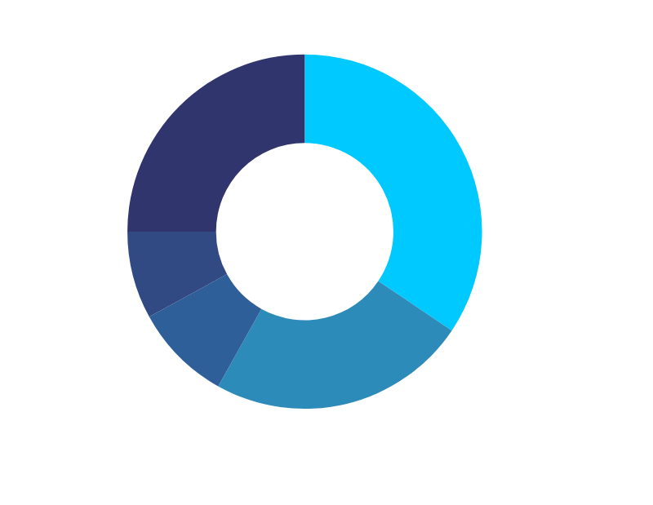
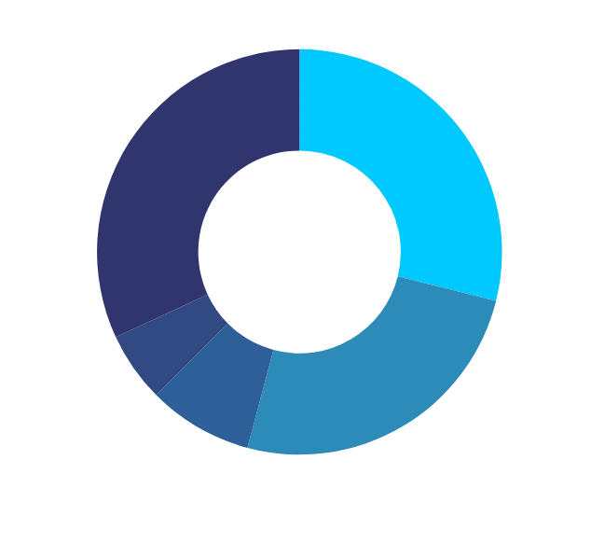
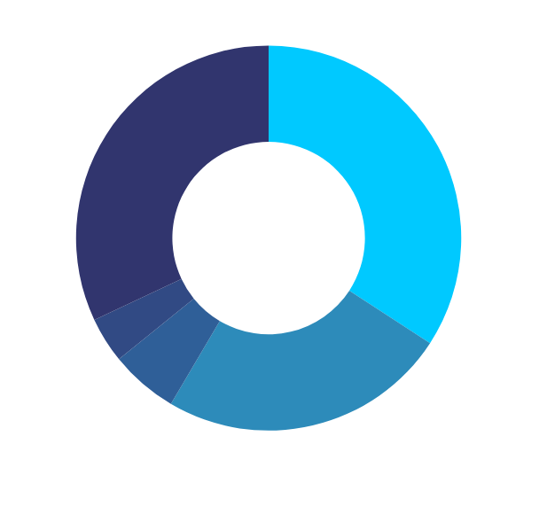
High-potential countries with fast-growing digital nomad hubs and limited coworking supply.
THAILAND
INDONESIA
VIETNAM

Slide 16
Identifying the Ideal Cities for Coworking Expansion
Ranking cities based on cost, demand, popularity, nomadlist, and safety.

Slide 17
KPI Definition:
Coworking Potential Score
Weighted combinationof 4 key factors:
Cost of Living - 30%
Coworking Demand - 30%
Popularity - 20% (No. of Digital nomads)
Nomad.com Rank - 20% (via Nomadlist)
All input values were normalized to a 1–5 scale

Slide 18

WARDIERE, INC.
Market Strategy
Focus on digital marketing, partnerships with fashion influencers, and collaborations with eco-friendly brands.

Slide 19
WARDIERE, INC.
Competitive Analysis
Comparison with competitors like Stylebook and Cladwell, highlighting unique strengths such as AI-powered suggestions and a strong focus on sustainability.

Slide 20
WARDIERE, INC.
Financial Projections
Over the next five years, we anticipate a steady increase in our user base, driven by aggressive marketing and strategic partnerships.

Slide 21

WARDIERE, INC.
Contact Information
HELLO@REALLYGREATSITE.COM - WWW.REALLYGREATSITE.COM

